Slide 1
November, 2015
Pulse Combustion Systems
Introduction

Slide 2
Topics
Company Overview
Technology Overview
Pulse Drying Basics
Comparison to Conventional Spray Dry
Advantages of Gas Dynamic Atomization and Rapid Drying
Patents
Recent Successes
Tech Time – Control System

Slide 3
Pulse Holdings LLC dba Pulse Combustion Systems
In Business Over 10 Years; Arizona LLC
Over 200,000 hours of Pulse Dryer Ops
Fifteen Units Sold; > 100 Truckloads Tolled
20,000 SF facility in Payson, AZ (Plant Tour)
Pilot Dryer for Product Development
P-1 Dryer for Scale-up Demo & Tolling
Successful Demo’s on >200 products
Superior Results all Product Categories

Slide 4
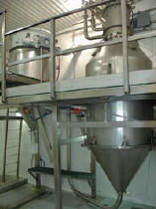
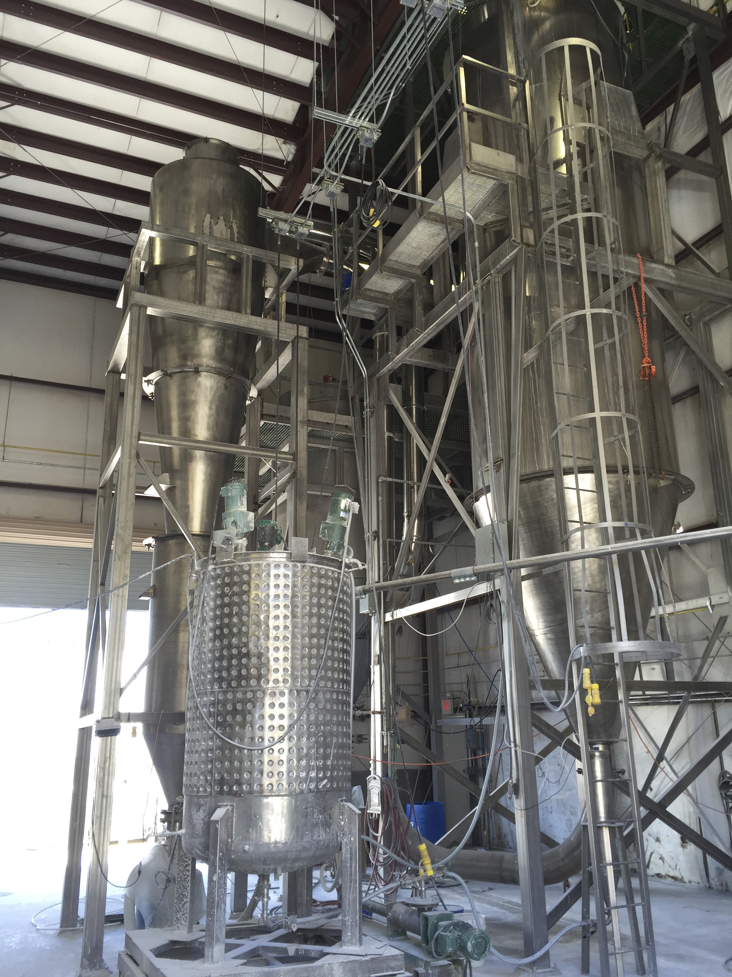
Pilot Dryer
P-1
Dryer Model | P-0.1 | P-0.5 | P-1 | P-2 | P-3
Heat Release BTU/hr | 100,000 | 500,000 | 1MM | 2MM | 3MM
Evaporative Capacity, lb/hr | 50 | 250 | 500 | 1000 | 1500

Slide 5
Technology Overview
Pulse Combustor Basics
Video – PCS Dryer in Action
Atomizer Distinctives
Implications & Advantages
Patents
Technical Info
Notes:
Within the Technology Review section we will address three particular components. Pulse Combustor Basics visually depicts the internal combustion sequence, Atomizer Distinctives details those points at which the Pulse technology differs from traditional spray drying technique, and Implications & Advantages highlights the benefits of those differences.

Slide 6
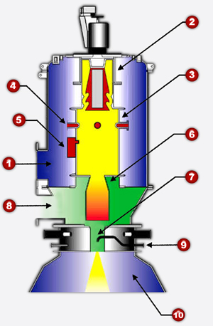
Pulse Combustor Basics
Air is pumped into the combustor’s outer shell at low pressure.
The air flows through the patented unidirectional air diode, and
Enters a tuned combustion chamber.
Fuel is added to the combustion chamber and mixes with the air.

Slide 7
The fuel-air mixture is ignited by a pilot and explodes, creating hot air about 3 psi above combustion fan pressure.
6. The hot gases rush down the spray dryer's tailpipe toward the atomizer (#7) . The air diode blocks upward flow from the combustion chamber. As the combustion chamber empties, the next charge of fuel and air enter. When they mix, the hot walls of the chamber cause ignition. The system runs at about 100 Hz.

Slide 8
Atmospheric Quench Air is blended in to achieve desired product contact temperature.
The atomizer releases the liquid into the gas stream, and dynamically controls atomization, drying and particle trajectory.
10. The atomized liquid enters a conventional tall-form drying chamber. The powder is retrieved using standard collection equipment, such as cyclones and baghouses.

Slide 9
PCS Pilot Dryer in Operation

Slide 10
Major Distinction From Conventional Spray Drying Is Atomization Process
 | Conventional Spray Dryer | PCS Pulse Dryer
Feed Pressure | High | Very Low
Feed Viscosity | Low | Low to Very High
Type of Atomization | Mechanical Shear | Gas Dynamic
Delta T (Typical) | 200F – 400F (?) | 400F – 700F
Drying Time | 30 sec | 0.5 sec
Drying Source & Atomization Source | Separate | Co-located

Slide 11
Shear-Free Spray Drying Makes a High Quality Powder
Gas Dynamic Atomization:
A Slow, Low-Pressure Feed Introduced into a
Pulsating Hot Gas Stream Prevents Delicate Bonds from Bursting.
No Mechanical Shear.
1200ºF
Feed Pipe / Atomizer
Notes:
Here we illustrate the atomization of a a Pulse Combustion Dryer. The high speed hot air is seen moving downward and feed is being injected into the gas stream. The fast moving air causes a division of the droplets. One becomes 2, and then 4, and the 8, and so forth. The concept is similar to what would happen if you were to dump a glass of water out your car window while the vehicle was moving. At 5 mph it would pour out on the ground normally, but if you did the exact same thing as 70 mph it would become a fine mist before it ever reached the pavement.

Slide 12
Higher Heat Transfer = Less Degradation
Direct Dryer Solids Exposure Comparison
Pulse
Flash
Conventional Spray
Avg = .5 sec
Avg = 3 sec
Avg = 20 sec
0 1 5 30 60
Residence Time (seconds)

Slide 13
Spray Chamber Temperature Zones
Spray
Pulse

Slide 14
Competitive Advantages of Pulse Combustion Dryers
Powder Quality/Characteristics
Very Short Residence Time = Less Degradation
No Mechanical Shear
Excellent Surface Characteristics
Freeze Dry Quality
Operating and Maintenance Costs
High Δ T = Lower Utility Costs
Ability to Handle Higher Solids in Feed = Even Lower Utility Costs
Low Pressure System Reduces Maintenance Costs by up to 90%
Advanced Control System is less labor intensive
Initial Dryer Acquisition Costs
Competitive Pricing
Modular Construction Reduces Installation Time and Cost

Slide 15
Patent Overview
Utility
Inlet Air Diode
Particle Size Control
Process – Pulse Drying of:
Condensed Distiller’s Solubles
Beneficial Live Viruses
Filed; In Process:
Pulse Drying of Egg Whites

Slide 16
Recent Demonstration/Operation Successes
Algal Slurries (3 projects)
Egg Whites, Yellows, Whole – Proteins & Lipids
Microencapsulations (Tolling for 3 Companies)
Plant Proteins
Crystallized Acid Whey
Dairy, Non-Dairy Creamers
Minerals, Metals (Incl. Lithium Battery Powders)
Polymers, Chemicals
Nutriceuticals (Humic, Extracts)

Slide 17
Postscript - Tech Time: Control System
PCS Dryer is PC Controlled; Runs Self; Collects Data
DaqFactory Software, Off the Shelf Components
Honeywell Flame Safety
User may customize
Slides Following:
System Overview Screenshot
HMI Data

Slide 18
Overview
PID
Start up
Notes:
This is the system overview screen. A variety of critical information is displayed and there are control buttons to feed product and water, turn the dryer light on and off, and operate the baghouse sequence. Clicking on the visual representations of the components themselves will bring up their respective pop-up windows. The next slide gives an example of one of the pop-up screens.

Slide 19
Startup
PID Menu
Overview
Notes:
This is the Startup screen. It will be your primary base of operations. From this screen you will startup the dryer. Also, nearly all dryer components can be monitored and controlled from this screen.
Working from left to right, top to bottom:
First Row: At the top are green/red on/off lights for the VFDs as well as some of the gas and air train components.
Second Row: First we have the fuel flow reading as a percentage of capacity and the heat release of the combustor. Next the exhaust temperature is shown. This is measured from the bottom of the drying chamber. Moving into the 3rd box we have powder temperature measured from the end of the piping just before the baghouse. Then the temperature of the stack exiting the baghouse and headed outside to the exhaust fan is shown. The 4th box contains the Auto Start and Shutdown buttons as well as a red indicator light. Continuing right we see the dryer light on/off switch with its indicator light. The 6th box gives the pressure inside the combustor and the pressure inside the vessel (drying chamber). Note that the vessel pressure usually should be negative. The final box gives the burner can temperature (inside the can surrounding the combustor but outside the actual combustor itself). and the internal combustor temperature.
Third Row: The 1st box displays the RAV motor speed (the motor which sits on the very top of the combustor) with the yellow text setting control. The tailpipe temperature (inside the combustor) is shown next and the RAV motor start and stop buttons are included at the bottom. The 2nd box gives the exhaust fan speed with its yellow text setting control, the stack temperature, and the exhaust pressure. Exhaust fan start/stop buttons are at the bottom. Continuing into the 3rd box we see the combustion air speed readout and the yellow text setting control for the CA fan. A Combustion Air temperature reading is displayed along with a pressure read-out. Combustion Air fan start/stop buttons are at the bottom. The 4th box provides the Quench Air fan speed, yellow text setting control, Quench Air temperature, and Quench Air pressure reading. Start/stop buttons are again at the bottom. Moving into the 5th box we see the fuel valve reading and the heat release reading with its yellow setting control text. We then have two buttons for switching between manual and automatic heat release settings. Below these buttons the contact temperature is listed with its yellow settings text. At the bottom are buttons for switching between automatic and manual control modes. The 6th box contains the feed pump speed and its yellow setting control text, exhaust temperature reading and its yellow text, and the automatic and manual mode selection buttons. At the bottom are the feed pump start and stop buttons. In the 7th and last Third Row box the Transportation Air Fan speed reading and its yellow text are given, the transportation air temperature, and the transportation air pressure. TA Fan start/stop buttons are at the bottom.
Fourth Row: The fourth row begins with Open and Close buttons for the Pilot and Turbo Air. Following the continuation of the startup sequence is depicted. Pilot ignition, on/off, and purge buttons are given next as well as a purge progress indicator. On the far right are readings of the feed density and feed rate.
The bottom of the Startup screen contains various reset buttons, a systems status reading, screen change buttons, and several blue indicator lights.

Slide 20
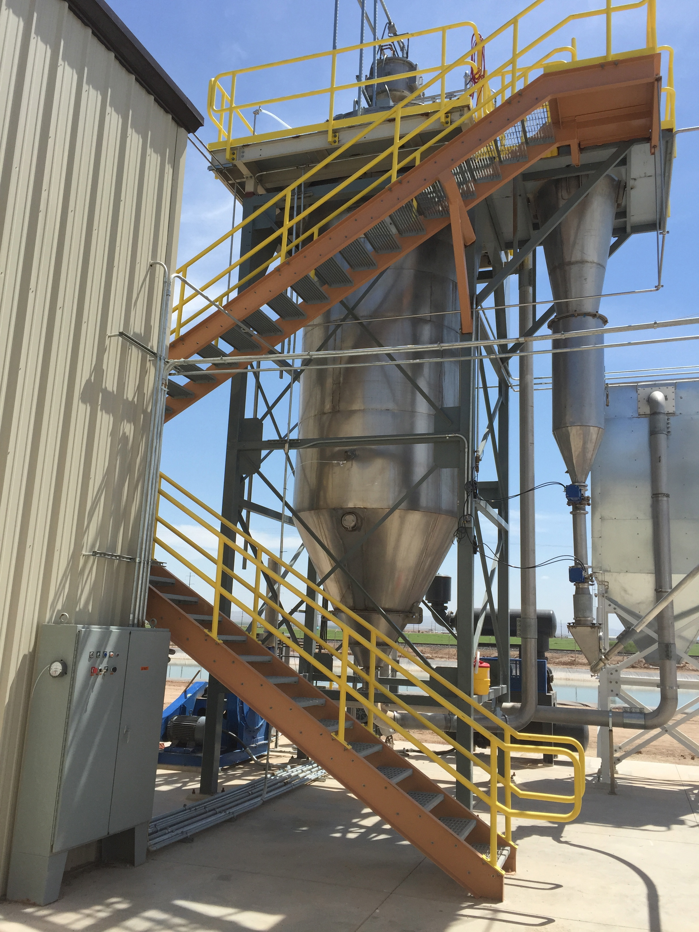
Thank you
Contact us via
www.pulsedry.com

