Slide 1
PULSE COMBUSTION SYSTEMS INTRODUCTION
Better Powders Through Advanced Technology
August 2021

Slide 2
About The Company
Products Formulated and Dried
Pulse Combustion Systems (PCS) Is The Industry Leader in Advanced Spray Dry Technology
250+
21
PCS Technology has produced superior results over traditional spray drying in all product categories
YEARS EXPERIENCE
300,000 hours of Pulse Dryer operations
25 custom Pulse units sold
400 truckloads tolled
20,000 SF facility in Payson, AZ
Pilot Dryer installed for product demos and development

Slide 3
Our Vision
Our vision at Pulse Combustion Systems is to work closely with our customers to solve their industrial drying challenges through the application of advance pulse technology.
Slides to Review:
Our Team
Services We Offer
Our Dryers
Technology Overview
Pulse Drying Basics
Comparison to Conventional Spray Drying
Advantages of Gas Dynamic Atomization and Rapid Drying
Patents
Recent Successes
2019 | PULSE Combustion Systems

Slide 4
Our Team
Years of experience to leverage
Jim Rehkopf
Hendrik Grobler
Marius Grobler
Brian Rehkopf
Founder
Chief Operations Officer
VP: Engineering
VP: Business Development

Slide 5
SERVICES WE OFFER
What can PCS do for you?
01 / Product Development
02 / Pilot Trials
PCS will start fresh on your product and create a consistent, dryable version with our in-house formulation ability.
PCS can help prove your product at a pilot scale using our in-house, 50 pound-per-hour evaporative rate Pulse dryer.
03 / Tolling
04 / Custom Dryer Fabrication
PCS can toll your product using our 500 pound-per-hour evaporative rate Pulse dryer.
PCS can create a custom Pulse dryer for installation in your facility. A turnkey solution.
2019 | PULSE Combustion Systems

Slide 6
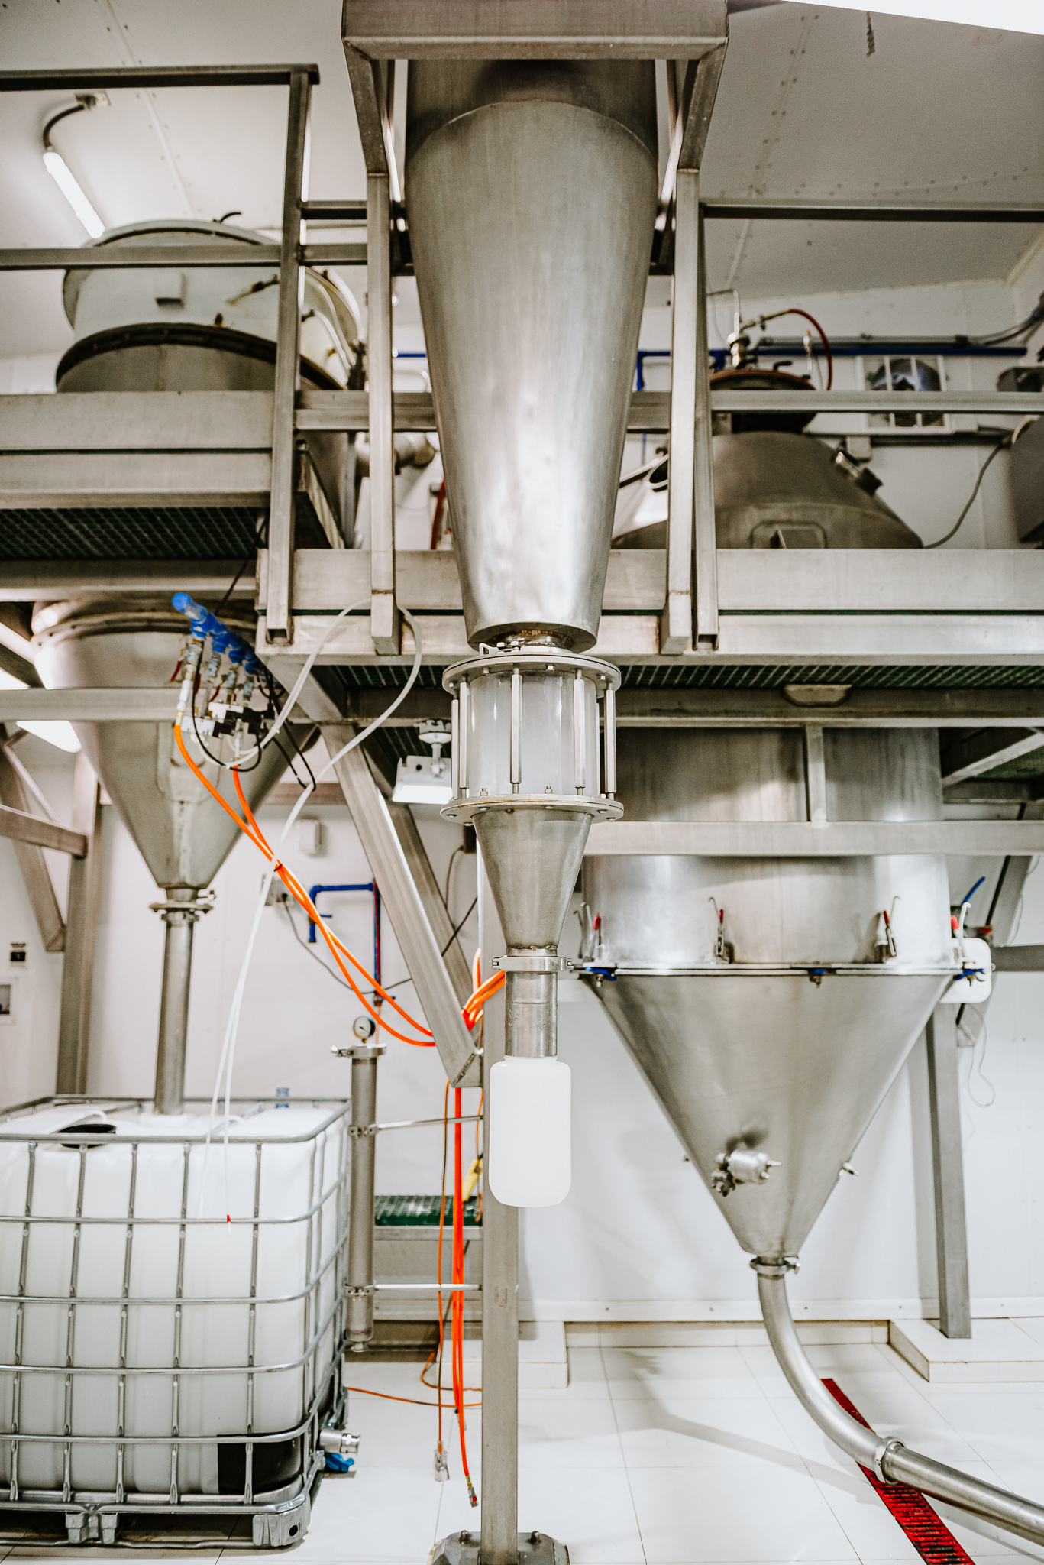
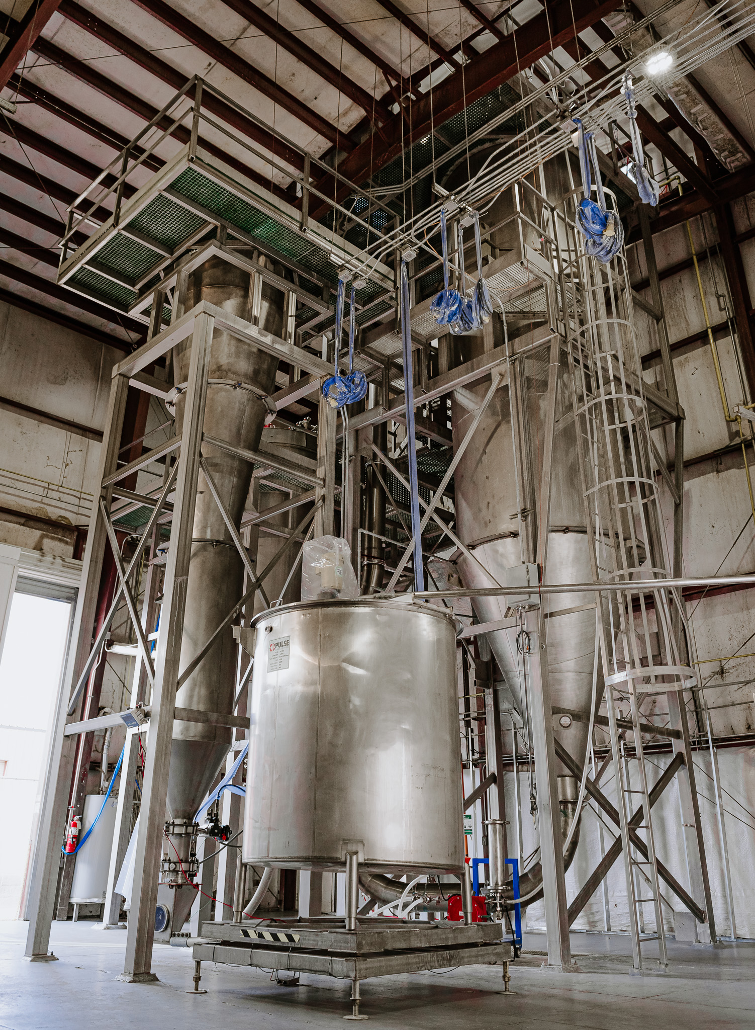
Pilot Dryer: P-50
Production Dryer: P-500
OUR DRYERS
PCS has installed two Pulse
Dryers on site dedicated for
client use
2019 | PULSE Combustion Systems

Slide 7
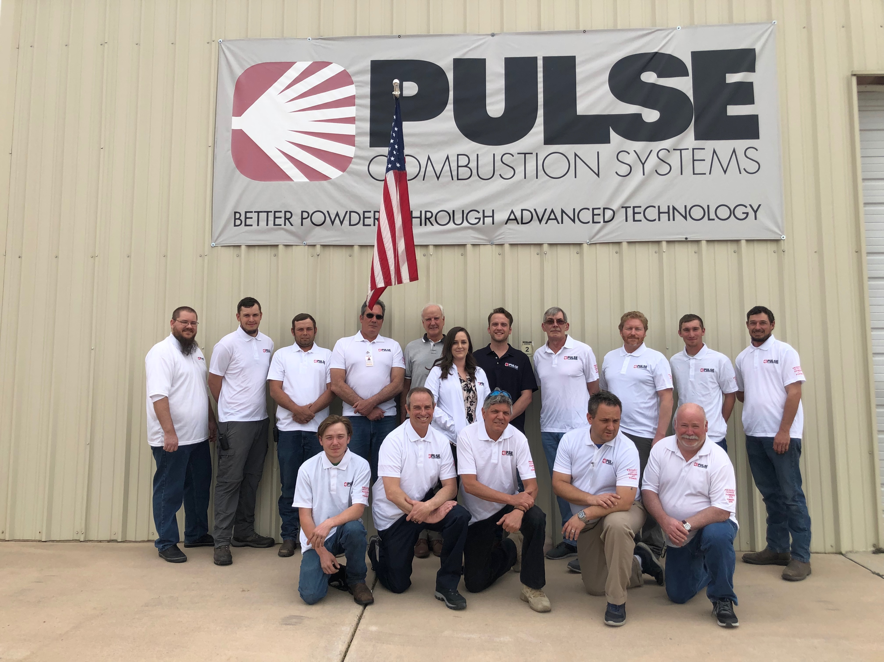
01
Video – Introduction to Pulse Atomization Drying
Atomizer Distinctives
Implications & Advantages
Patents
Technical Info
Technology Overview
02
03
Upcoming topics about our technology
04
05
06
2019 | PULSE Combustion Systems

Slide 8
Introduction to Pulse Atomization Drying

Slide 9
Major Distinction From Conventional Spray Drying is Atomization Process
 | Conventional Spray Dryer | PCS Pulse Dryer
Feed Pressure | High | Very Low
Feed Viscosity | Low | Low to Very High
Type of Atomization | Mechanical Shear | Gas Dynamic
Delta T (Typical) | 200F – 400F (?) | 400F – 700F
Drying Time | 30 sec | 0.5 sec
Drying Source & Atomization Source | Separate | Co-located

Slide 10
Shear-Free Spray Drying Makes a Higher Quality Powder
Gas Dynamic Atomization:
A slow, low-pressure feed introduced into a pulsating
hot gas stream prevents delicate bonds from bursting.
Low mechanical shear.
Feed Pipe / Atomizer

Slide 11
Spray Chamber Temperature Zones
Contact Temperature:
Pilot: 500 F - 1,200 F (260 C - 650 C)
P1: 900 F – 1,500 F (480 C – 800 C)
Hot Spots, Inconsistent Temperatures
Exit Temperature:
Pilot: 140 F - 280 F (60 C - 140 C)
P1: 160 F – 280 F (70 C – 140 C)
Spray
Pulse

Slide 12
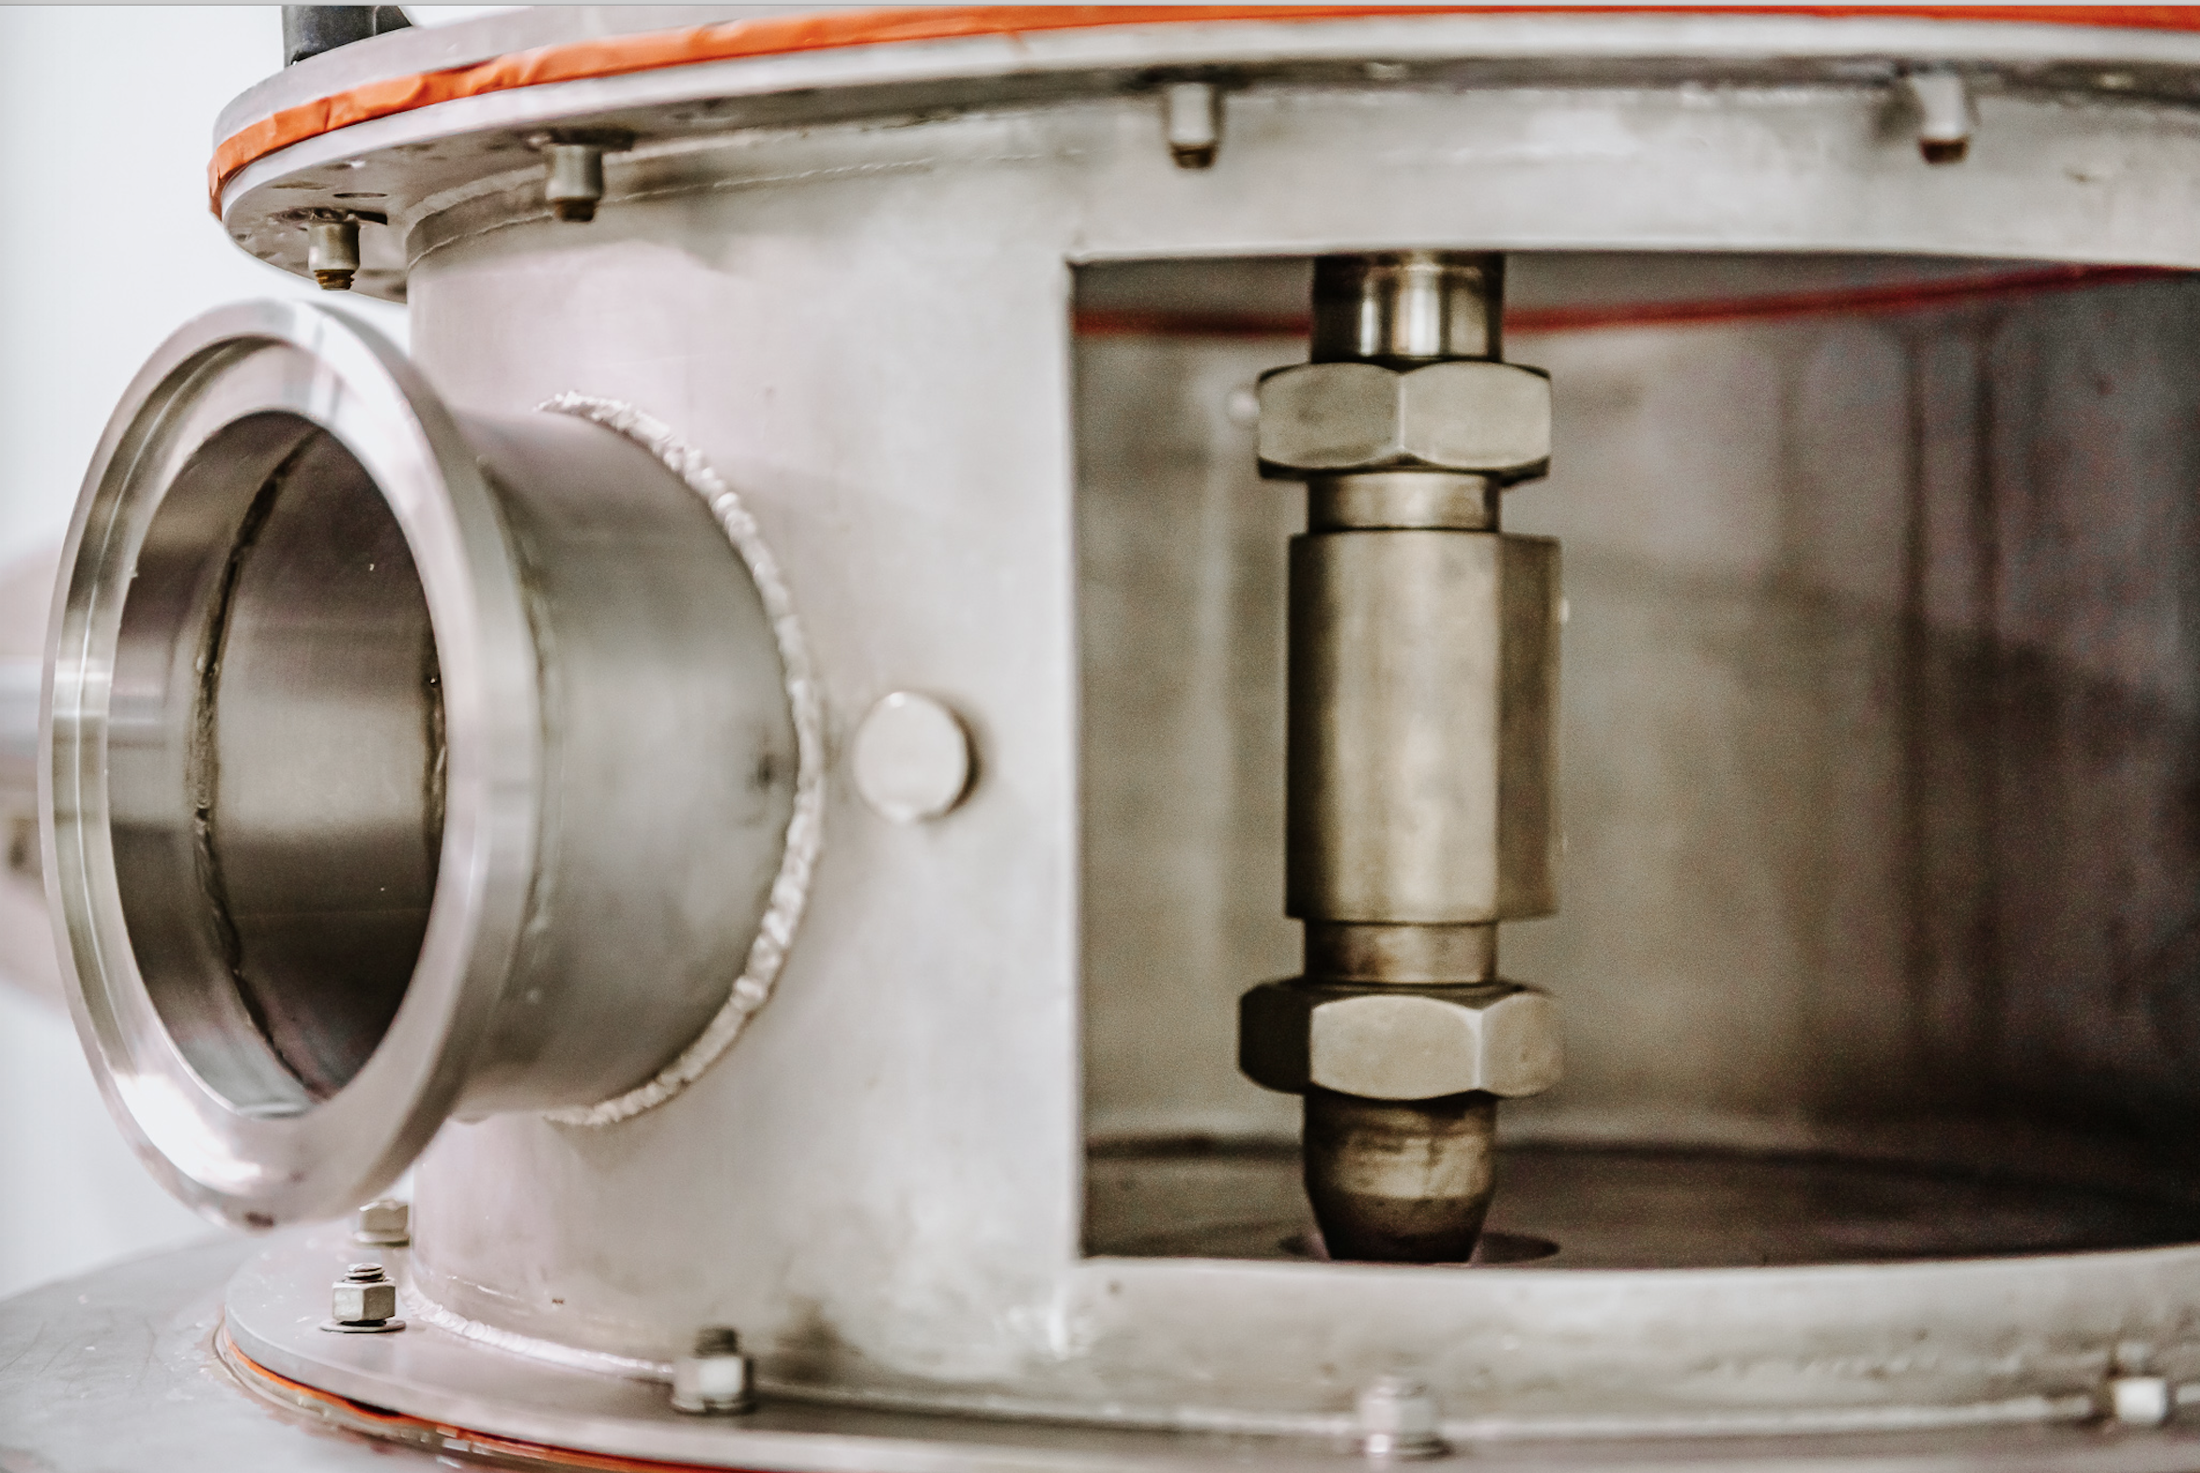
Competitive Advantages of Pulse Atomization Dryers
Powder Quality/ Characteristics:
Very short residence time = less degradation
No mechanical shear
Excellent surface characteristics
Freeze dry quality
Operating and Maintenance Costs:
High Delta T = lower utility costs
Ability to handle higher solids in feed = even lower utility costs
Low pressure system reduces maintenance costs by up to 90%
Advanced control system is less labor intensive
Initial Dryer Acquisition Costs:
Competitive pricing
Modular construction reduces installation time and cost

Slide 13
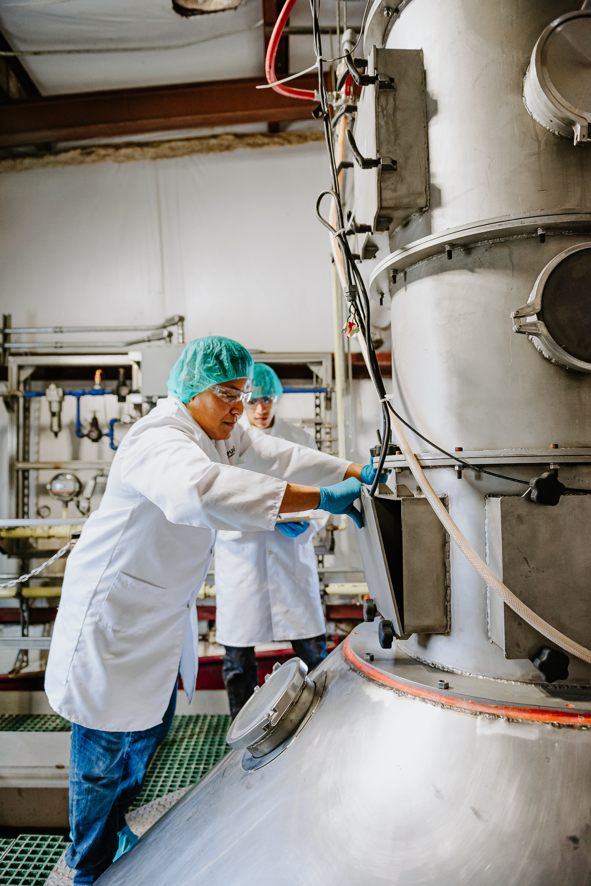
Utility:
Inlet Air Diode
Particle Size Control
Our Patents
Process – Pulse Drying of:
Condensed Distiller’s Solubles
Beneficial Live Viruses
Pulse Drying of Egg Whites
Filed; In Process:
Pulse Drying of Protein Isolates
Protein Extraction Methods

Slide 14
Recent Demonstration/ Operation
Successes
Algal Slurries (3 projects)
Egg whites, yellow, whole – Proteins & Lipids
Microencapsulations
Plant Protein Slurries
Crystallized Acid Whey
Dairy, Non-Dairy Creamers
Minerals, Metals (Incl. Lithium Battery Powders)
Polymers, Chemicals
Nutraceuticals (Humic, Extracts)
CBD Emulsions
2019 | PULSE Combustion Systems
14

Slide 15
Thank You!
Pulse Combustion Systems
Where to Find Us:
1509 W Red Baron Road, Payson, AZ 85541
Visitors are always welcome, get in touch and we’d love to show you around!
(928) 472-9333
inquiries@pulsedry.com
Social Media
Linkedin
Facebook
15

